Slide 1


COMPLAINT REDRESSAL SYSTEM
(Group-2)

Slide 2
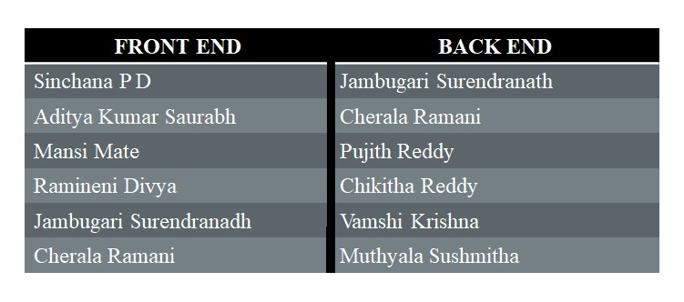
GROUP MEMBERS

Slide 3
INTRODUCTION
ABC Telecom Ltd. is one of India’s major telecommunication service providers offering landline, mobile phone and Fiber optic broadband services across the country. Their customer services group is interested in providing a set of customer redressal services through the development of a new application using the state-of-art technologies such as Spring-boot for the development of java-based services, and UI using Angular and integrate them suitably, so that all the necessary services are taken care of through this application.
ABC Telecom Ltd
Landline
Mobile Phone
Broad band Services
Customer Redressal Services

Slide 4
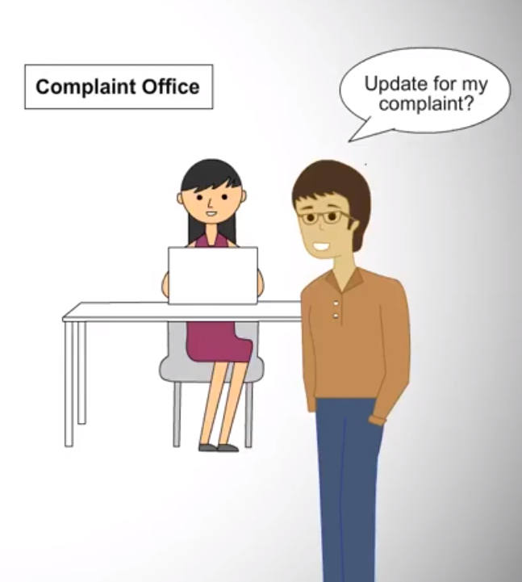
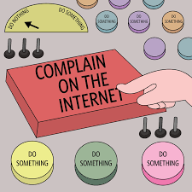
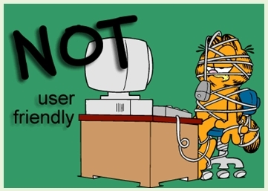
EXISTING SYSTEM
In the existing system, people must go to the office for any kind of help.
The users can post their problems but cannot get the details of the problems and some other services.
This system doesn’t have much popularity and is not user friendly.

Slide 5


PROPOSED SYSTEM
In the proposed system, the user can raise their complaint through Online without going anywhere.
Customer can login into the portal and can view and track the complaints related to the services availed by them.
Customer can give the feedback on the resolution of the complaint and based on that feedback, admin can take decision.

Slide 6
FLOW DIAGRAM
Start
Admin
Manager
Engineer
Customer
Maintains the life cycle of Customer,
Manager and Engineer
View all the Tickets and Status.
Assign Complaints to different Engineers.
View Customer Feedback.
View and work on complaints and assign the new status.
View the customer feedback.
Can raise and track the complaints and provide feedback.

Slide 7
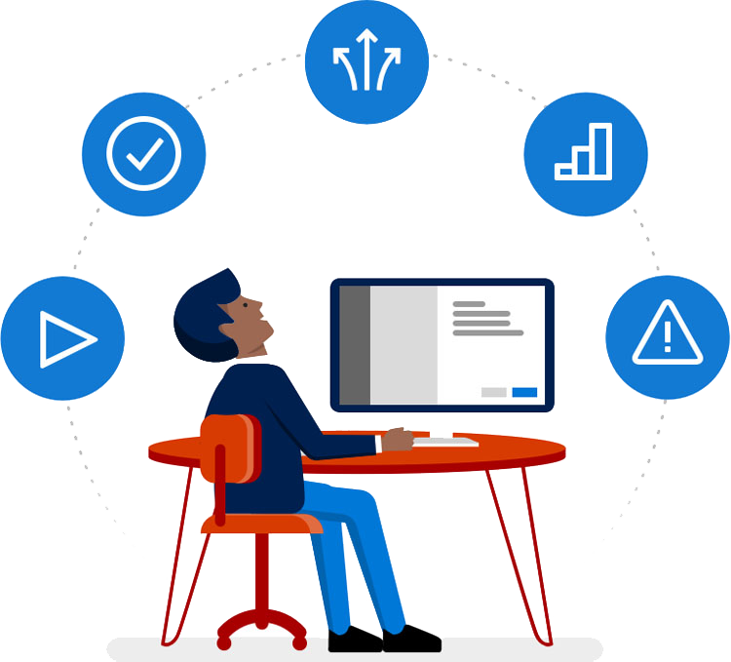





REQUIREMENS
Front-End: Angular
Server-side: Spring Boot
Back-end: MYSQL, Hibernate
Server: Tomcat

Slide 8
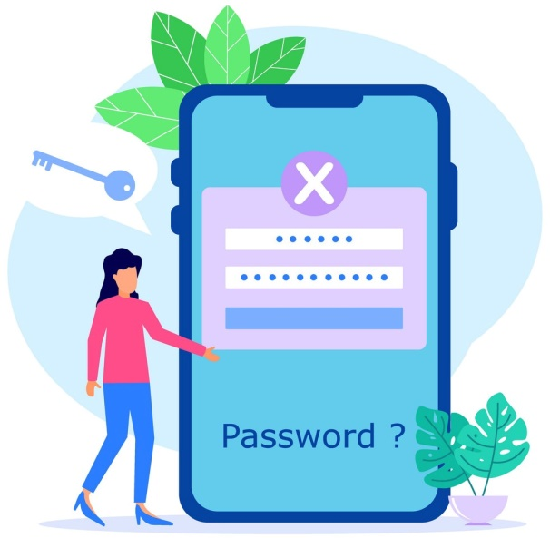

ASSUMPTIONS
Each User(Admin, Customer, Manager, Engineer) must have a valid Email and Password.
Customer must be login to the system to raise their complaints.
Only Admin can delete and update the records.
Managers can assign and view the complaints of the customers.
Complaints
Manager

Slide 9

ADVANTAGES
Digital Complaint Records
Less Time Consuming
Complaint resolved in short period of time
Reduce the cost of poor quality

Slide 10
DATABASE DESIGN SCHEMA
Domain Objects
Admin
Customer
Manager
Engineer
Login
Register
Register
Register
View Manager
Login
Login
Login
View Engineer
Complaint
Feedback
Feedback
View Customer
Feedback
View Complaints
View Feedback

Slide 11
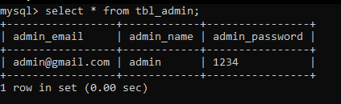
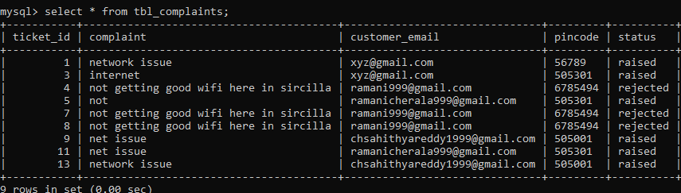
DATA DIRECTORY
Admin
Complaints

Slide 12
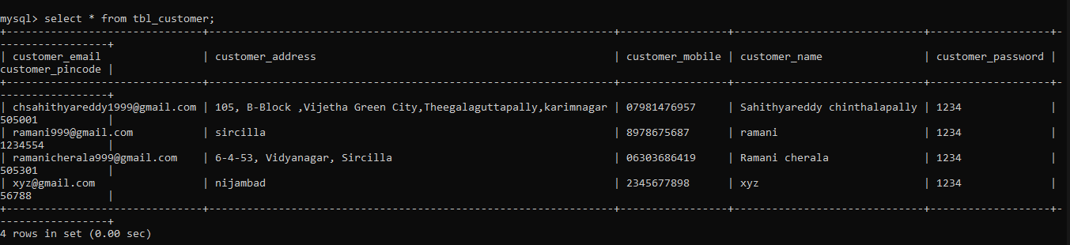
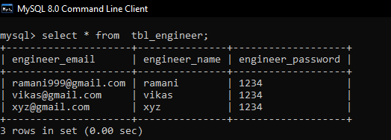
Customer
Engineer

Slide 13
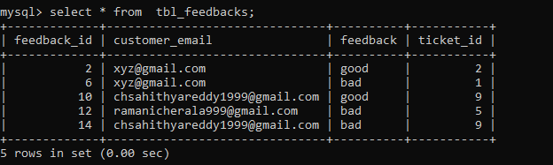
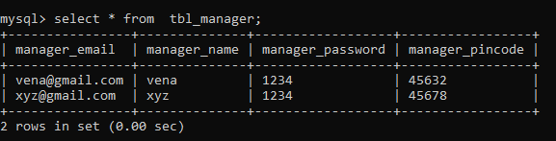
Feedbacks
Manager

Slide 14
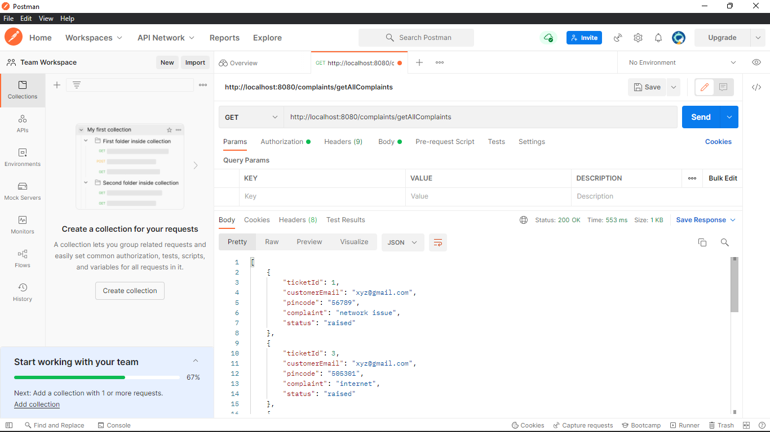
TESTING
Functional Testing

Slide 15
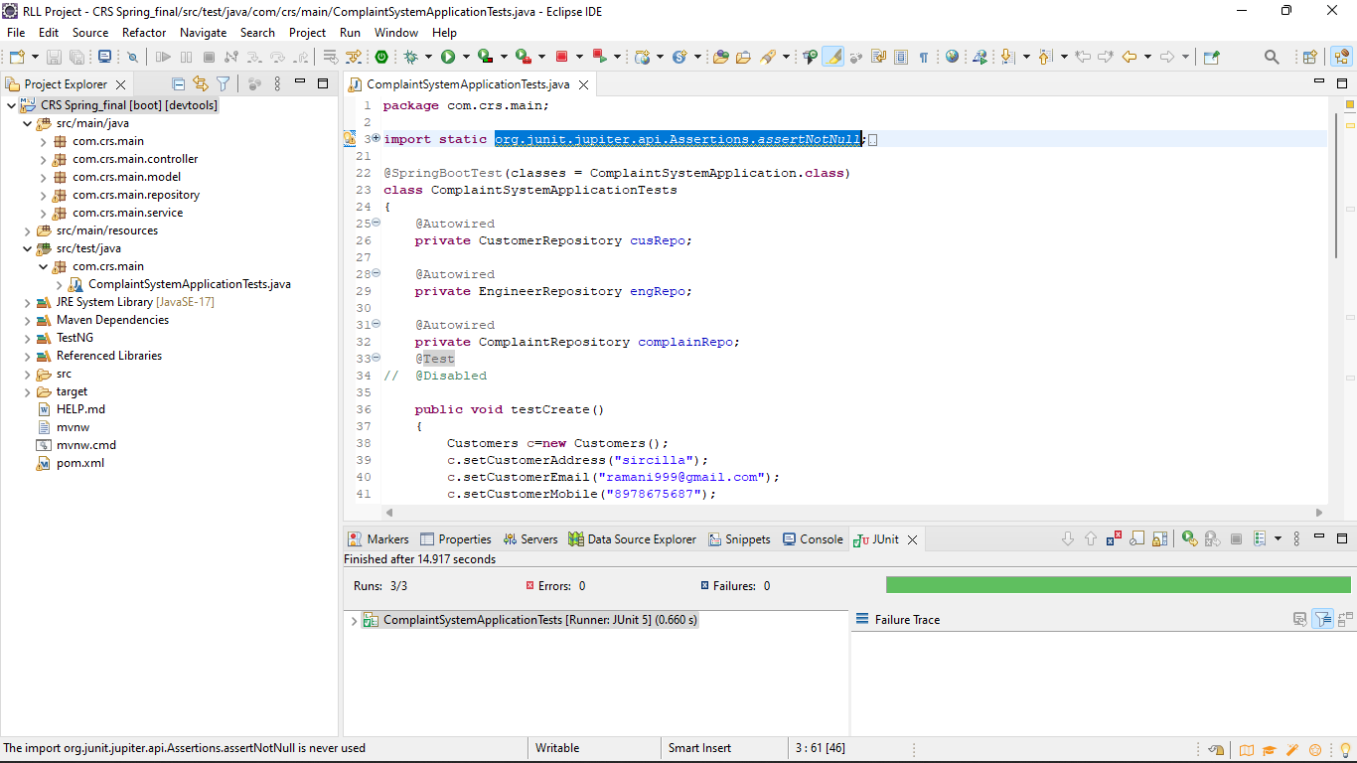
Junit Testing

Slide 16
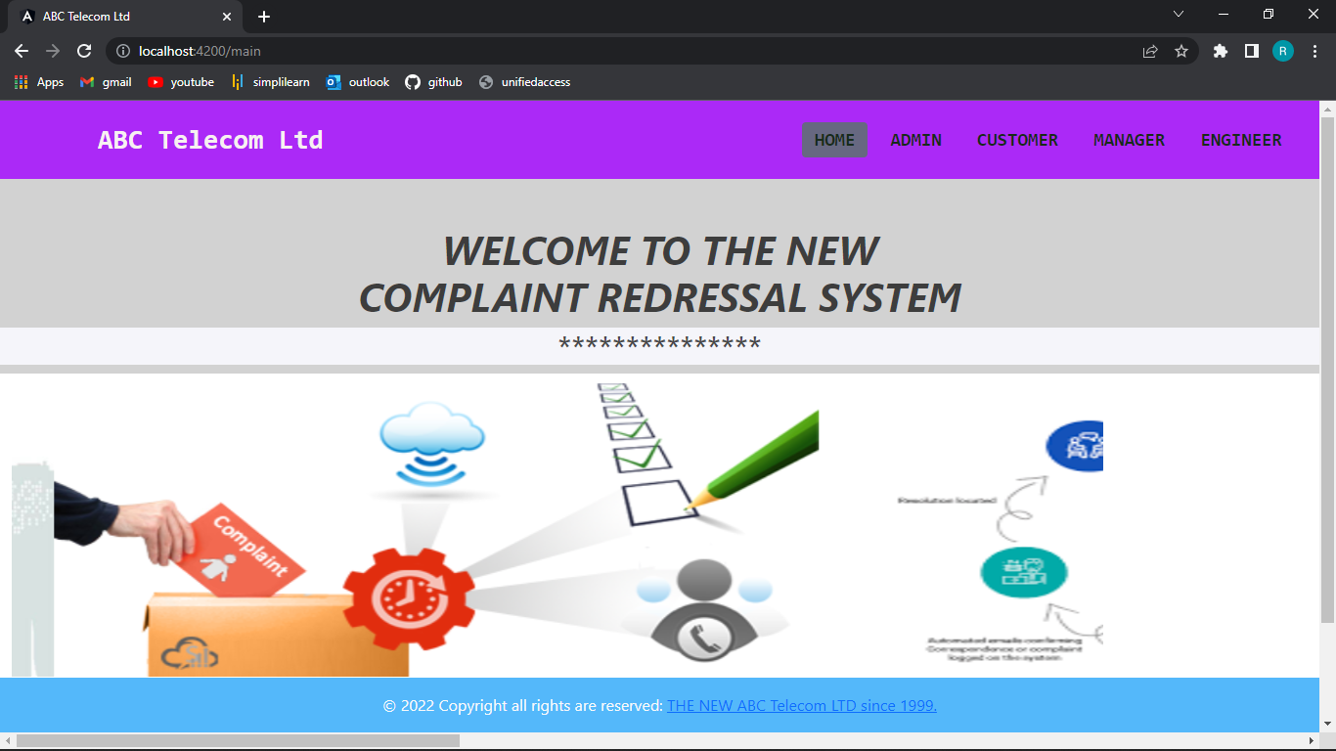
HOME PAGE

Slide 17
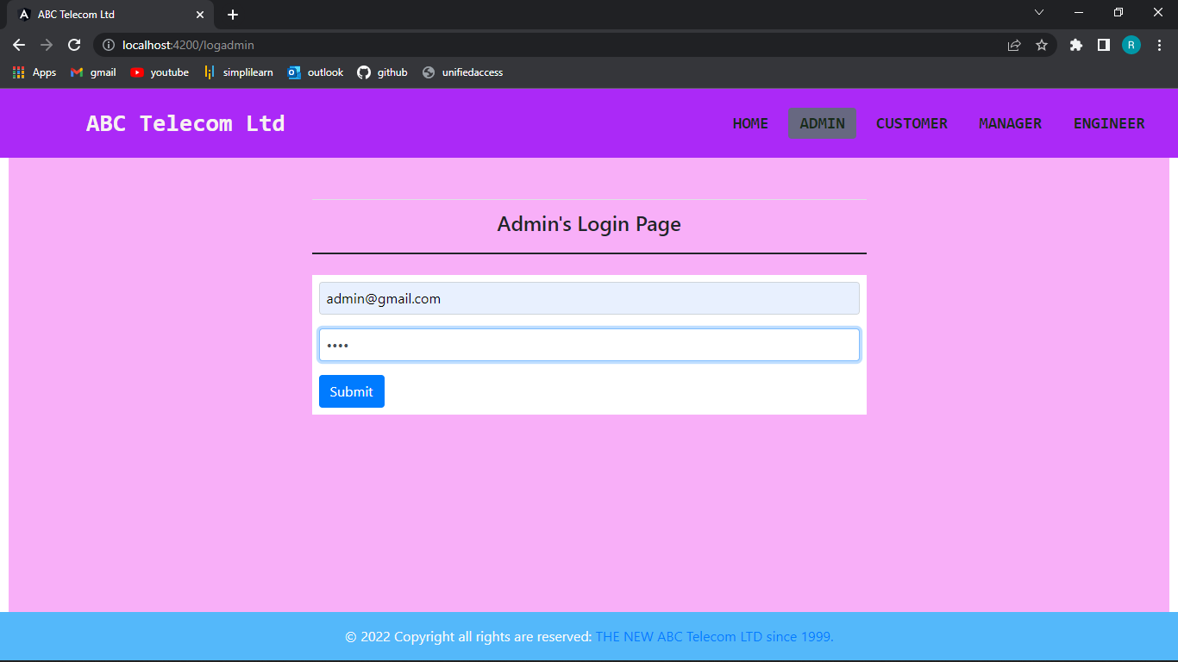
ADMIN PAGE
Login Page

Slide 18
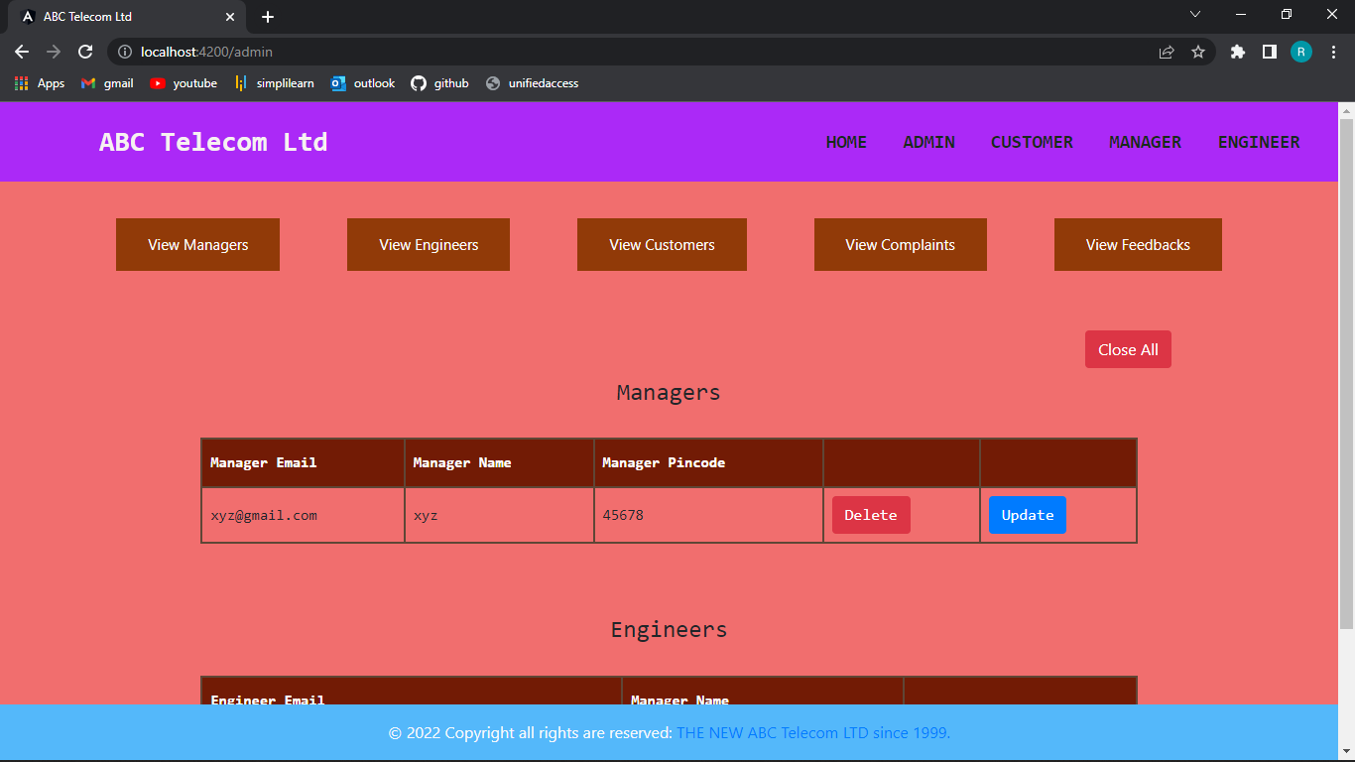
View Managers

Slide 19
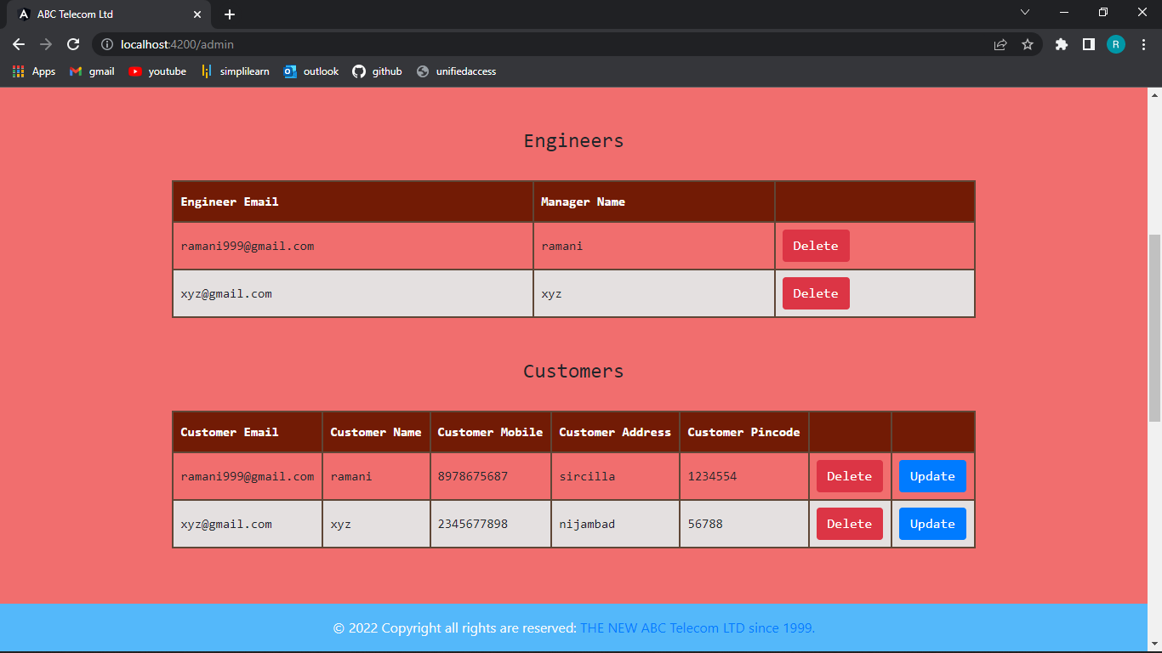
View Engineers and Customers

Slide 20
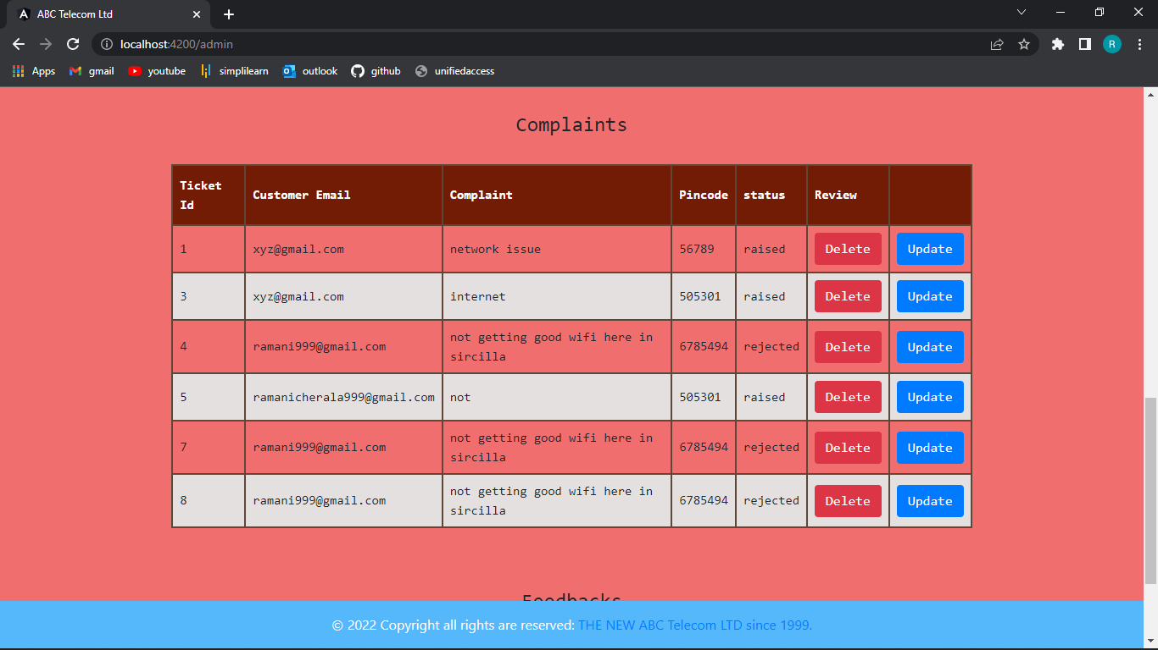
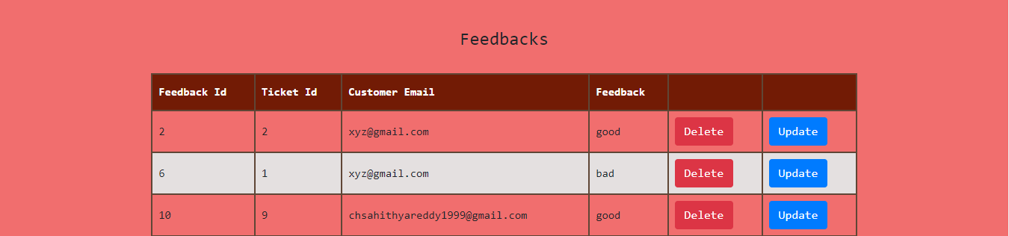
View Complaints and Feedbacks

Slide 21
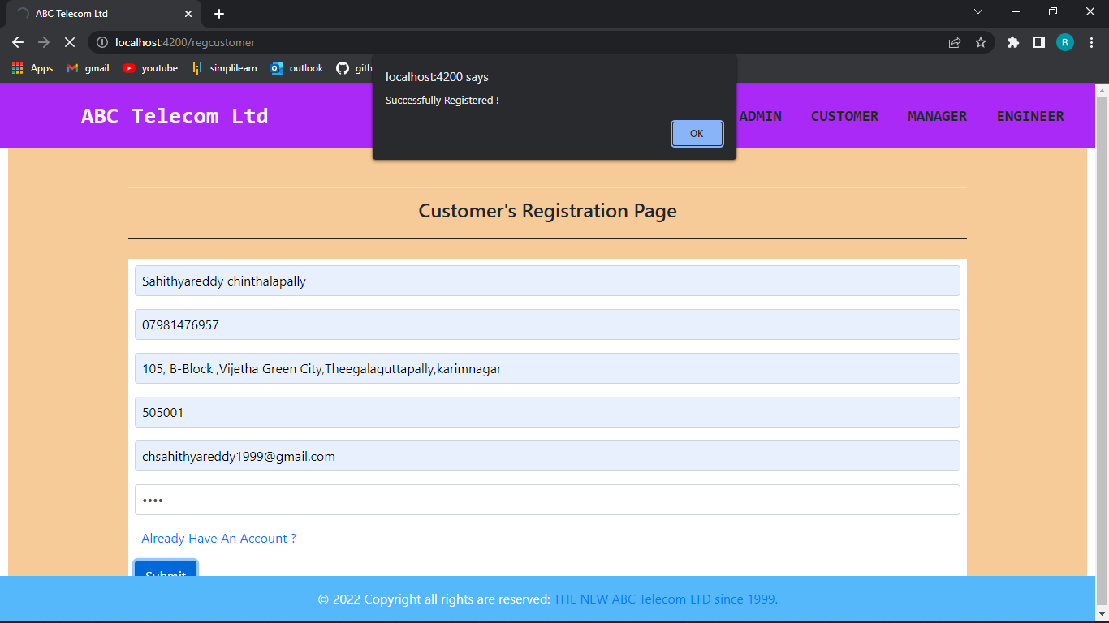
CUSTOMER PAGE
Registration Page

Slide 22
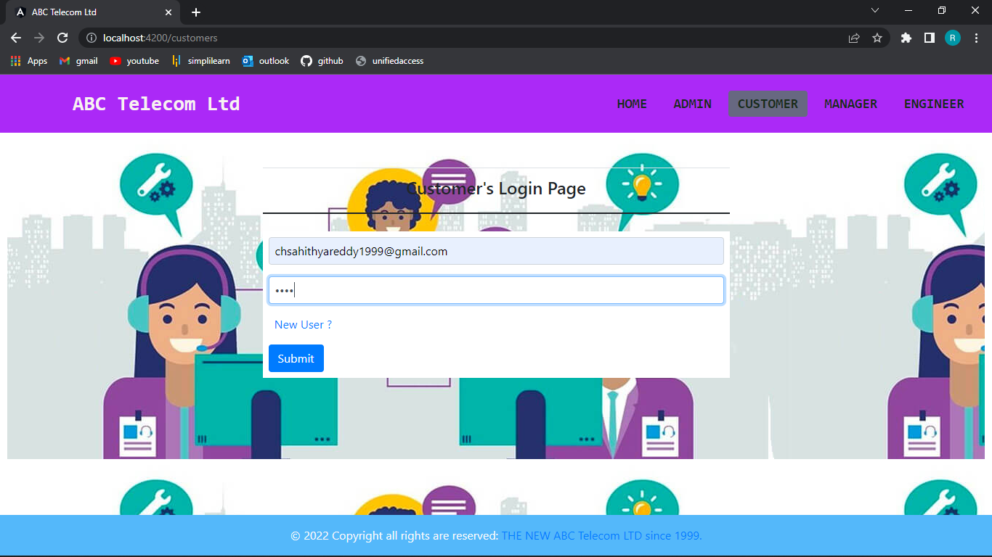
Login Page

Slide 23
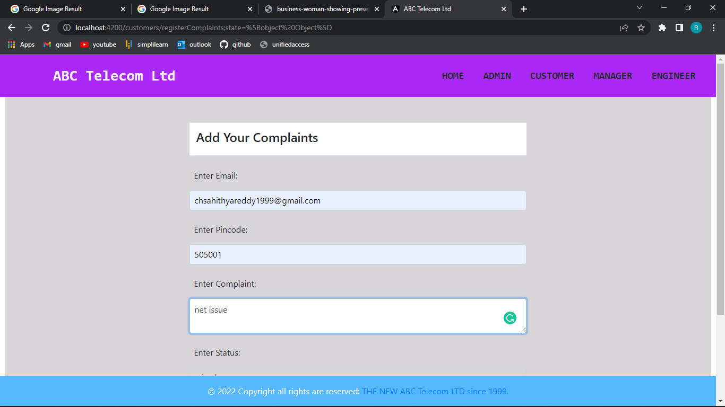
Complaints Page

Slide 24
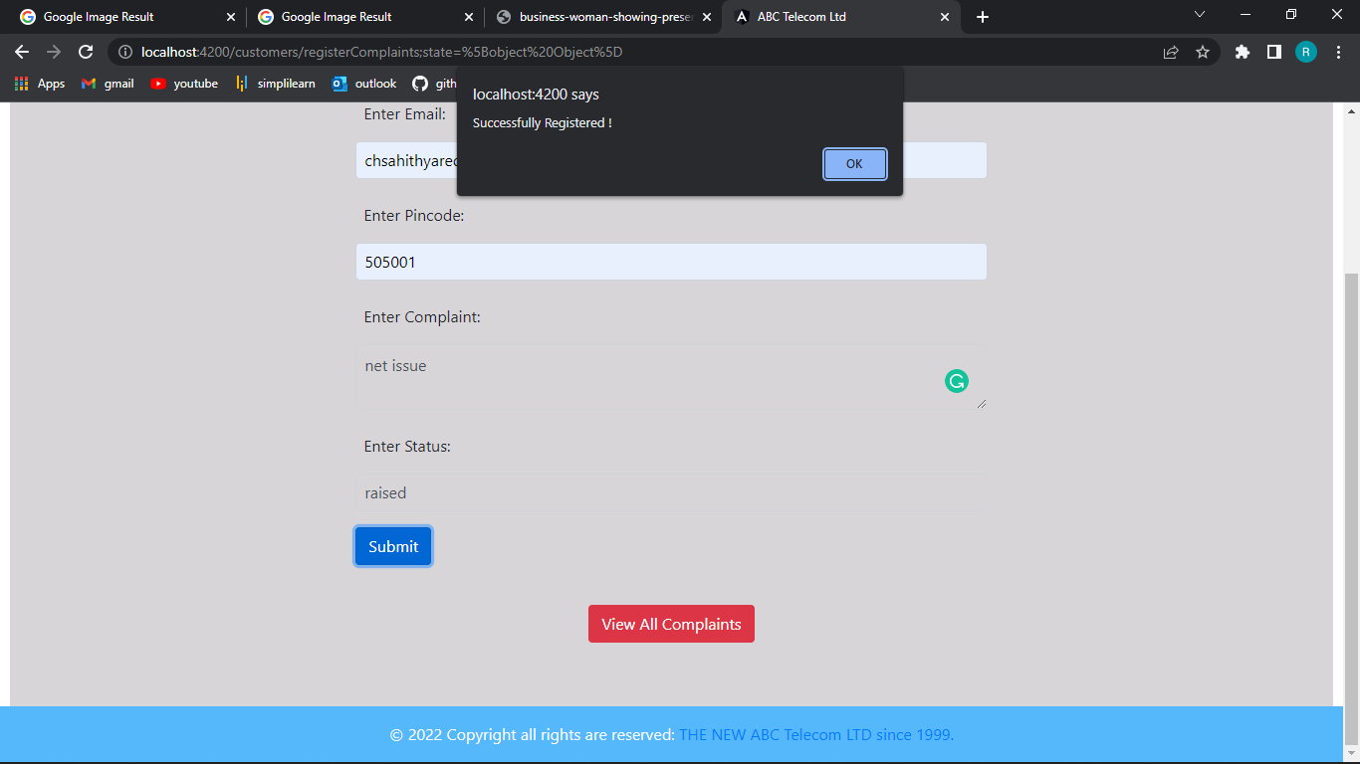
Registration Successful

Slide 25
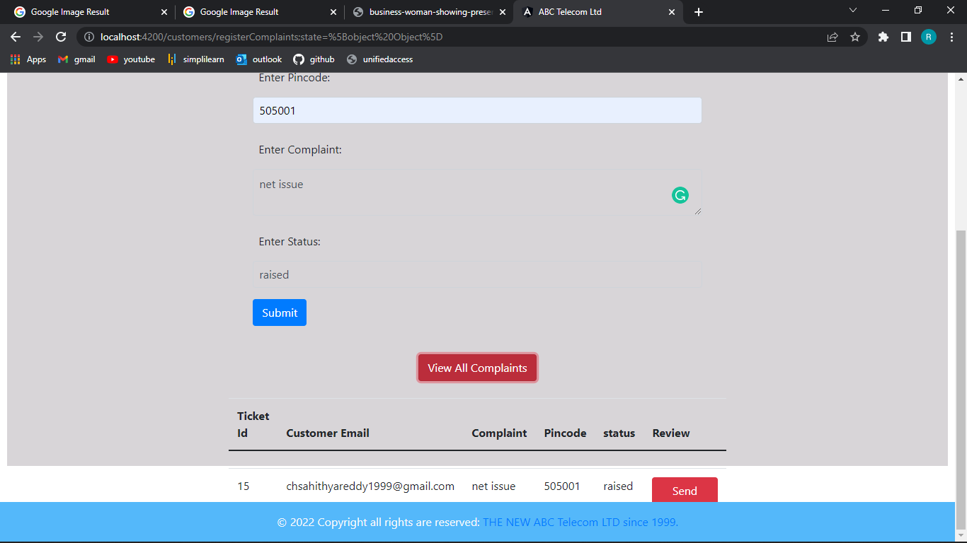
View Complaints

Slide 26
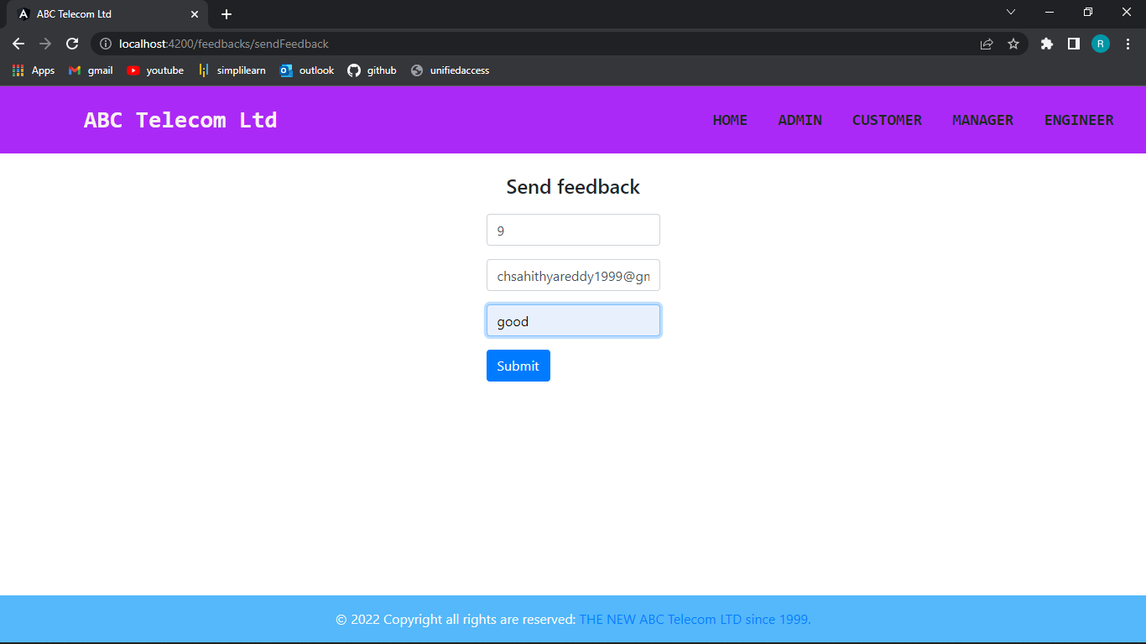
Feedback

Slide 27
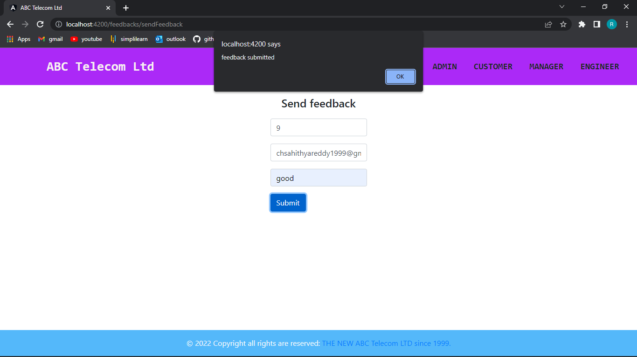
Feedback Successful

Slide 28
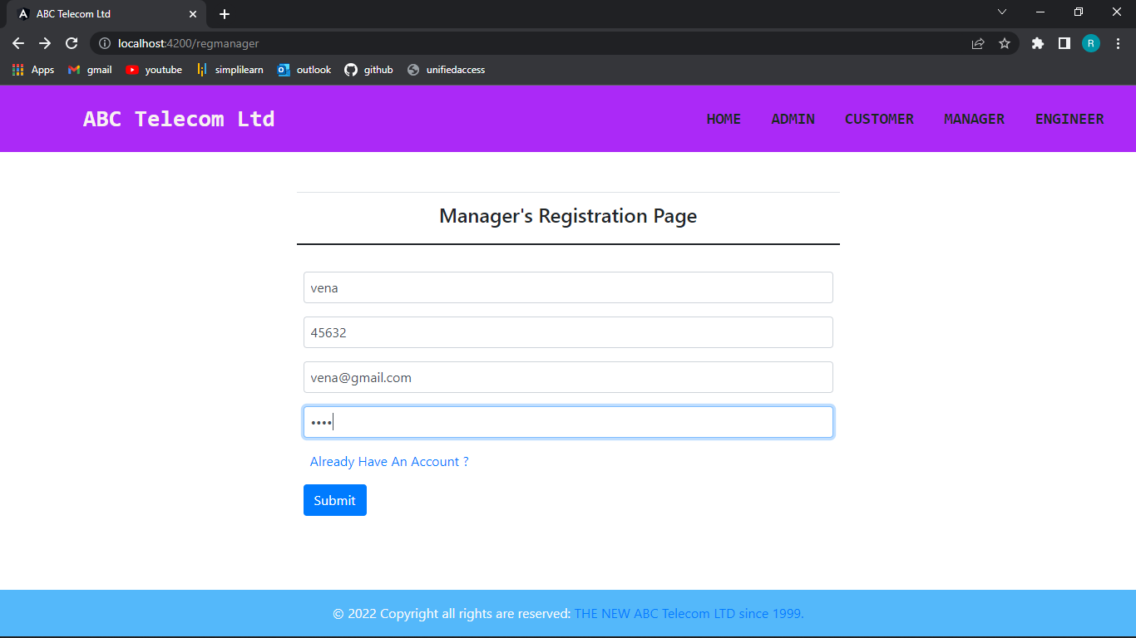
MANAGER PAGE
Registration Page

Slide 29
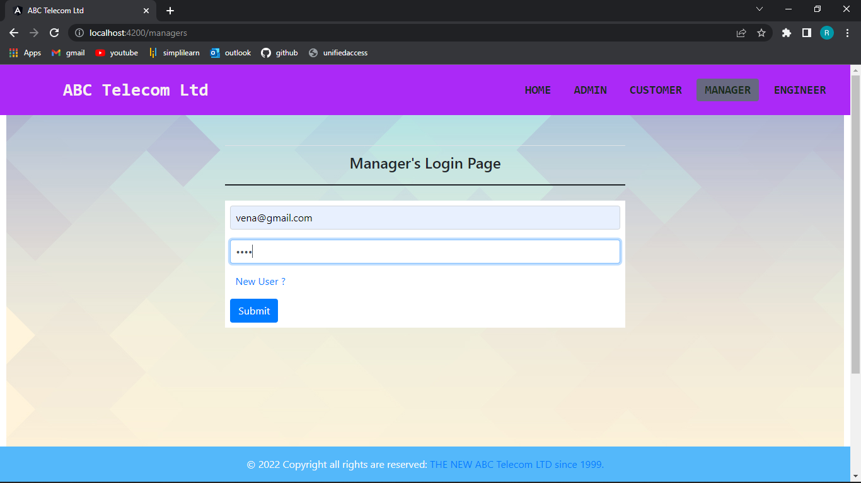
Login Page

Slide 30
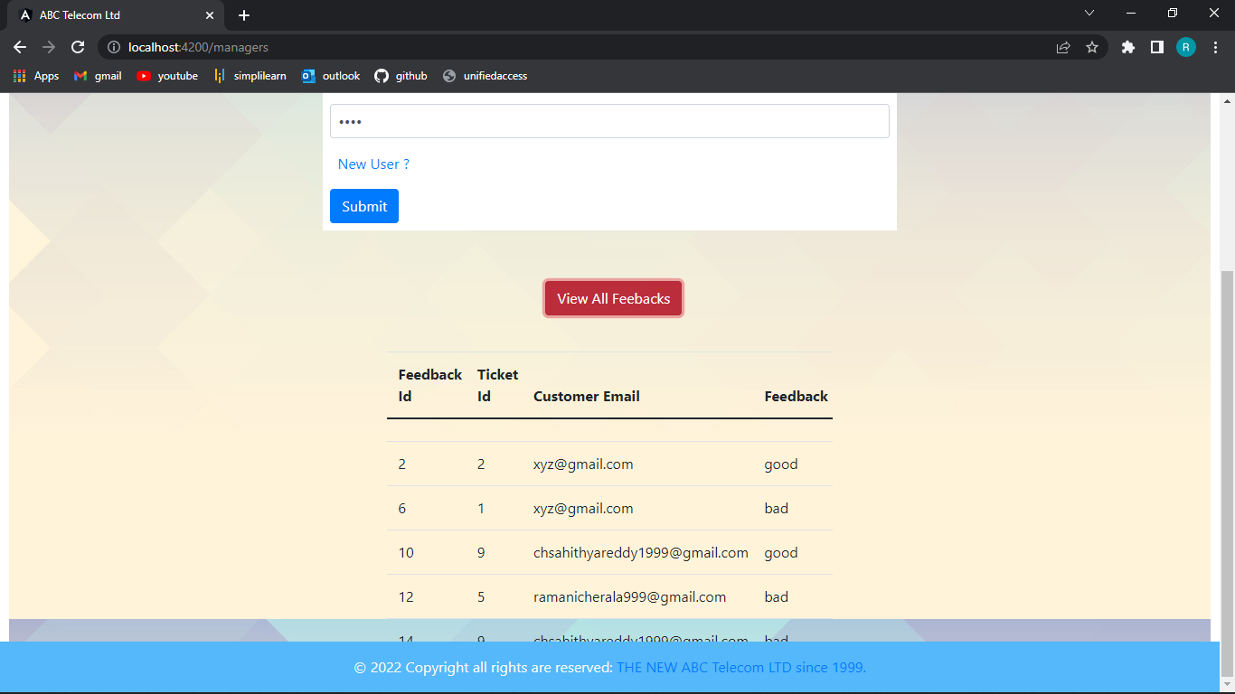
View Feedback

Slide 31
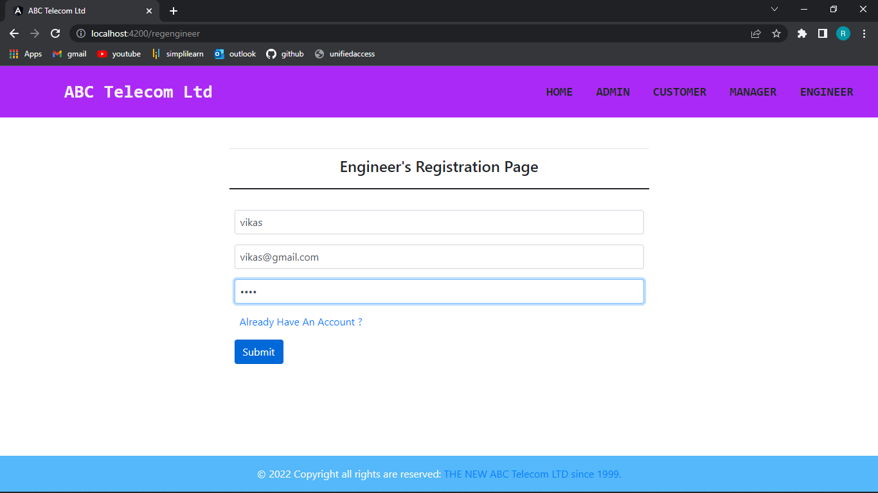
ENGINEER PAGE
Registration Page

Slide 32
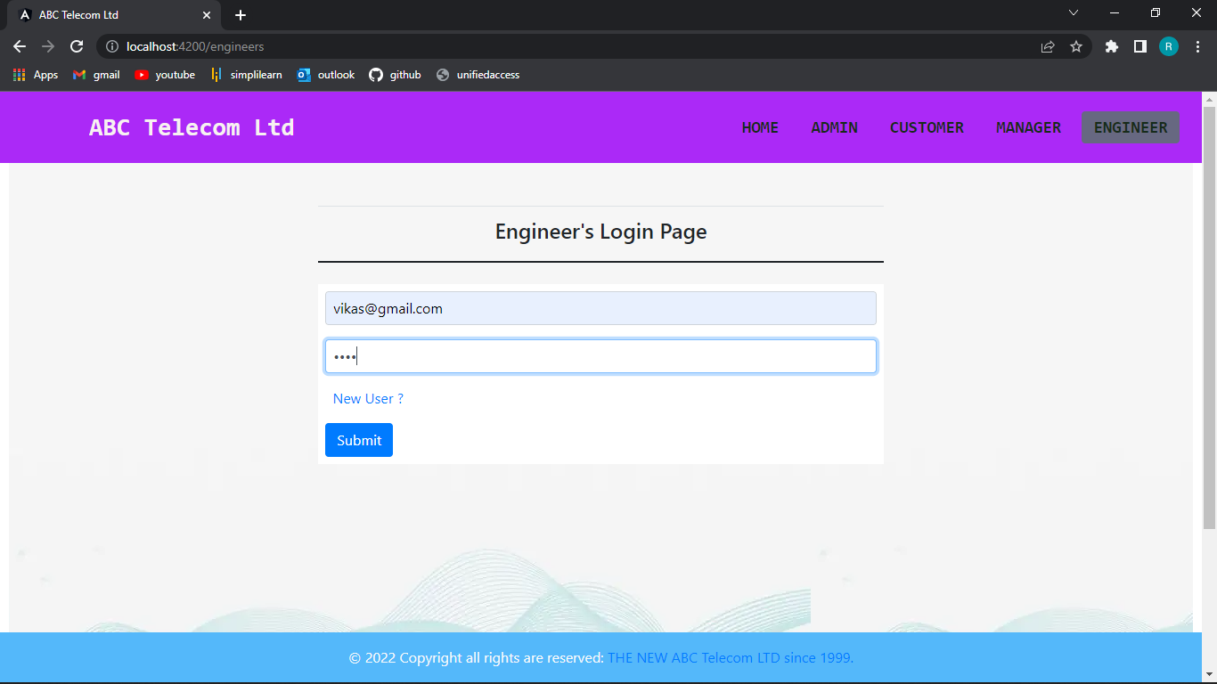
Login Page

Slide 33
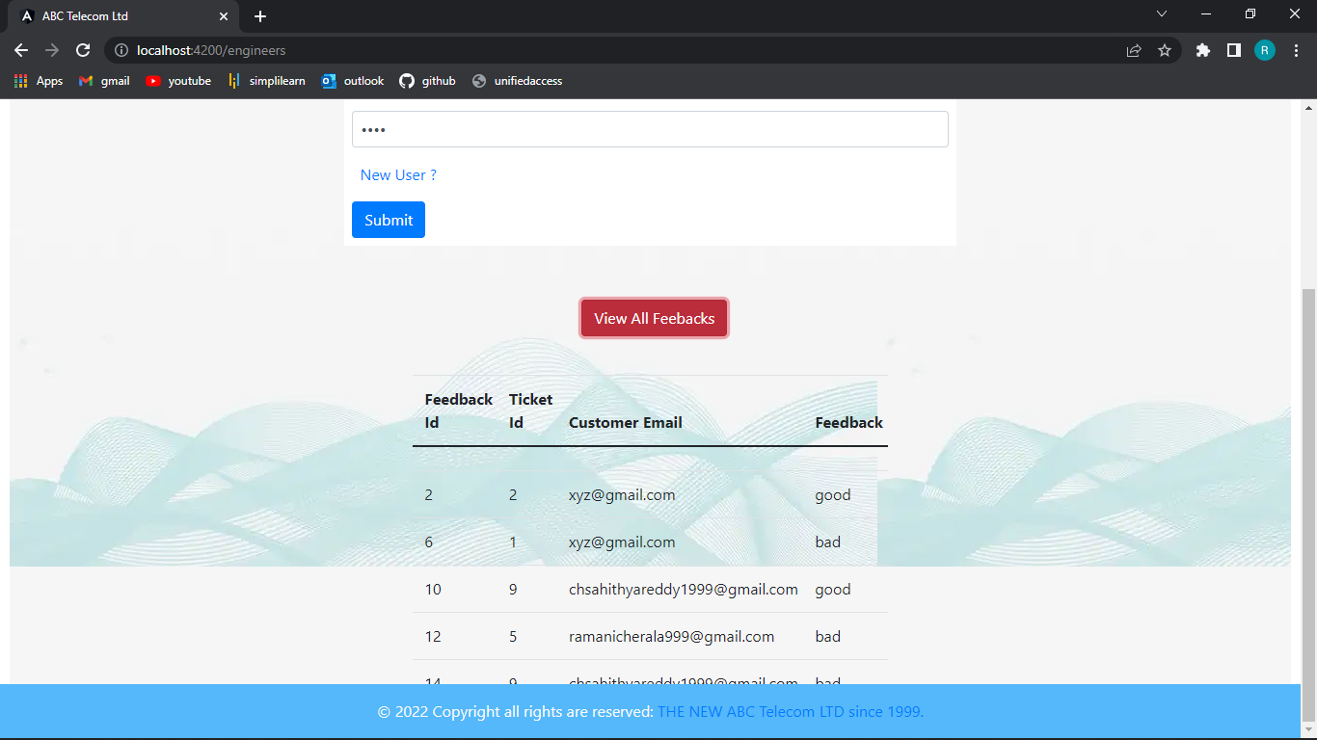
View Feedback

Slide 34
CONCLUSION
Application software has been computed successfully and was also tested successfully by passing all the test cases.
It is user friendly and has required options, which can be utilized by the user to perform desired operations.

Slide 35


